Slide 1
FEEDBACK AND DEBRIEFING

Slide 2
Headline Principles
Learn debriefing by actually doing it
Self-directed learning
Debriefing is a
Continuity of experience
Experiential learning
Need a strategy

Slide 3
Preparation
“Set”
  Environment
  Visual
  Audio
  Comfort
Psychological safety
Timing
  Immediate
  Hot
  Cold

Slide 4
Areas to be Considered
Personal reaction
1
5
2
CRITIQUE
Links to Real World
Discussion of events
CORRECTION
EVALUATION
4
3
DISCUSSION
Intended Learning Outcomes
Discussion of problems

Slide 5
Lederman’s 3 Phases of Debriefing
1
2
3
Systematic reflection & analysis
Intensification & personalisation
Generalisation & application

Slide 6
Kolb’s Model
Concrete experience
(feeling)
Reflective observation
(watching)
Abstract conceptualisation
(thinking)
Active experimentation
(doing)
Who, What, When Where, How
Feelings, Perceptions, Thoughts
Impartiality, Judgement
Different perspectives
Policies, Rules
Refine operating procedures
Application of outside experience

Slide 7
How?
Individual
Small group
Wider group
Everybody needs to be able to speak
Not everybody has to speak!

Slide 8
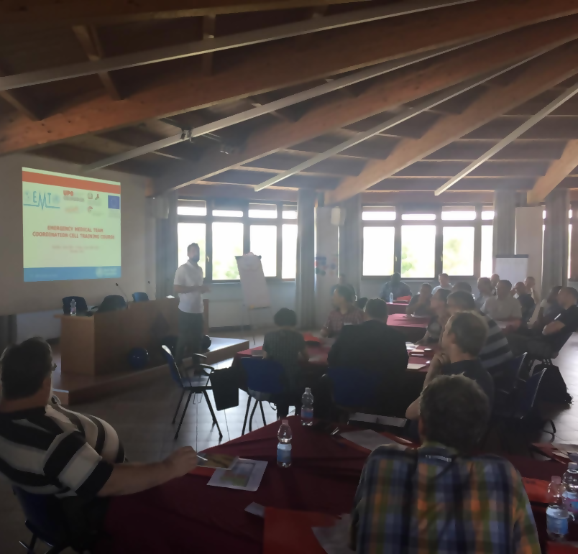
People Management Techniques
Management of over-talkers
Invitation of quiet people
Keep things moving
Stick to time!!!

Slide 9
Key Learning Points
Have a plan
01
02
Safety
Situational awareness
Event analysis
03
04
05
06
Positive forward message
New perspectives identified

