Slide 1

TIME
MANAGEMENT

Slide 2
Content
Goal
Learning Objectives
Time Management Theory
  Definition
  Behavioural Dimensions
Time-keeping and steering / Maintaining momentum
  Time-keeping during exercises
  Performance curve
Break management
Inject Planning
Task Planning
Operational “time-out” management
  “Time-out” management during exercises
  10 for 10 Principle
Recognising and managing deviations and disruptions
Tips for time management during the deployment
1
7
2
8
3
4
9
10
5
6

Slide 3
1. Goal
To learn how to deal with different situations in relation to time-management in the overall implementation of the TEMAS training package
The different situations which demand successful and effective time management include:
  Time keeping and steering/maintaining momentum
  Break management
  Inject planning
  Task planning
  Operational “time-out” management
  Recognising and managing deviations or disruptions

Slide 4
2. Learning Objectives
Up on completion of this session, participants will be able to:
Understand the general concept of good time management during a simulation exercise
Apply time management and planning skills appropriately to the various training situations
Adjust the simulation exercises to deviations
1
2
3

Slide 5
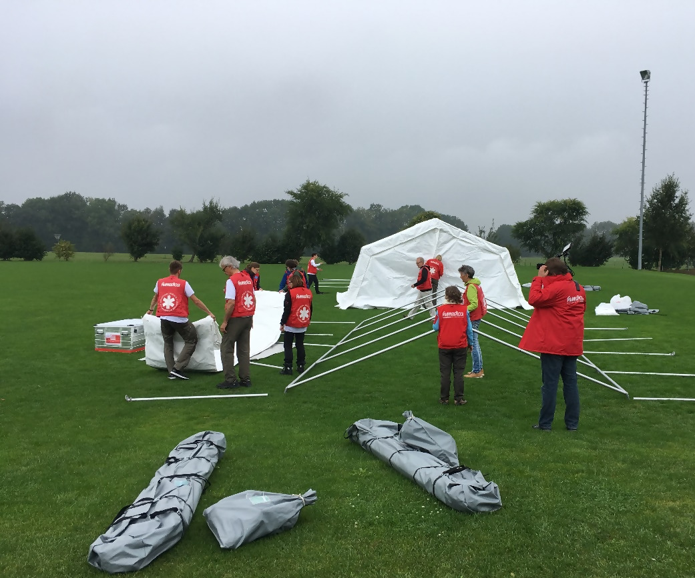
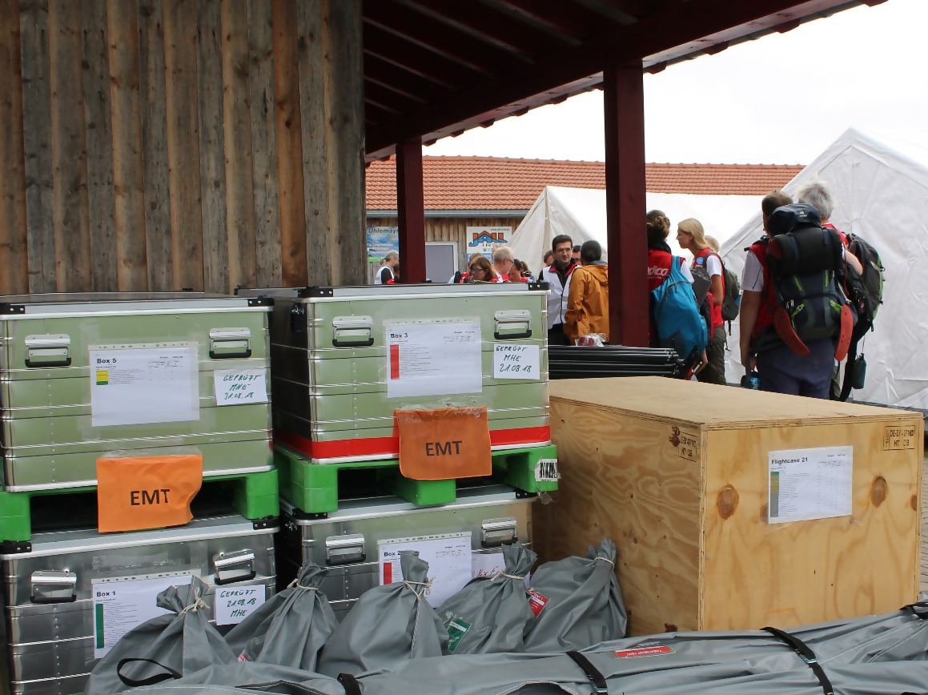
3. Time Management Theory

Slide 6
3.1. Definition
Time itself cannot be managed, simply because it is an inaccessible factor.
Only the way in which a person deals with time can be influenced.
Time management should thus rather be understood as an instrument to monitor and control the use of time
Time management involves the process of determining needs, setting goals to achieve these needs, prioritising and planning tasks required to achieve these goals
The trainers need to adapt the instructions on time management for each exercise to their specific context.
→

Slide 7
3.2. Behavioural Dimensions
1. Time estimation:
→ Be aware of the here and now, as well as the past and the future.
→ Be generally aware of how one's own time is used
Accept tasks and responsibilities that lie within one's own capabilities
Set goals
Plan tasks
Prioritizing
Create to-do lists
Group Tasks
The first two dimensions time estimation and planning are basically indicated in the training package. However, it is recommended that the user carefully goes through the trainings package and visualizes how they will facilitate each exercise while reflecting on the capacity of their training team, their particular training context and available resources which can impact the time estimations and planning.
2. Planning:

Slide 8
3.2. Behavioural Dimensions
3. Monitoring:
Observing the use of time in the execution of activities
Generation of a feedback loop allowing limiting the influence of interruptions by others
Affect current activities either directly (e.g. by acceleration or deceleration) or indirectly (e.g. by removing distractions from the environment)
The last two dimensions need to be carefully taken into consideration by the trainer while implementing each exercise.
4. Execution:

Slide 9
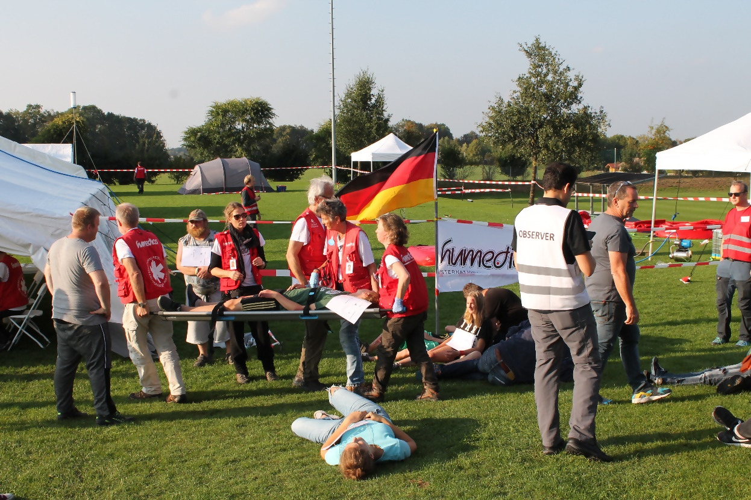
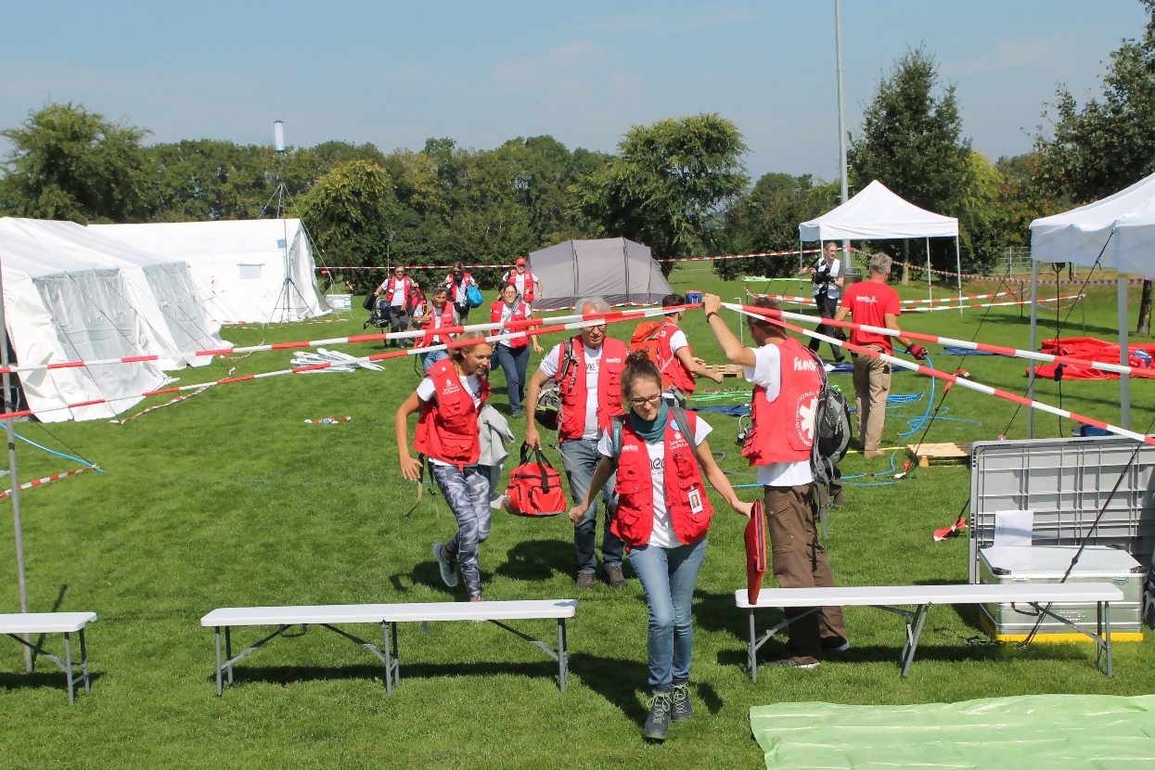
4. Time-keeping and steering / Maintaining momentum

Slide 10
4.1. Time-keeping during exercises
It is recommended to keep within the time indicated for each exercise
However, depending on the training venue and set-up, you may need to adjust the time for each exercise. These adjustments should preferably happen in the planning phase.
Always keep the objective in mind and check if the team is still working towards the intended objectives. If not, redirect the team in their performance accordingly.
Each exercise will have several objectives. However, some of them are key to the exercise and should be prioritised if you realize that not all can be achieved.
Enough time should be allocated for the debriefing sessions as they are key to the learning curve of each participants:
2/3 of the time for the exercise itself, and 1/3 of the time for the debriefing.

Slide 11
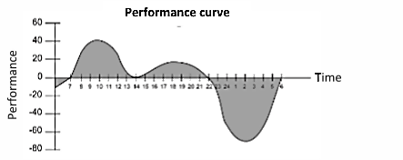
4.2. Performance curve
Perfomance Curve
You should think about ways and motivation exercises to keep the performance as high as possible even in typical phases of low performance.
Plan breaks accordingly and as far as possible avoid scheduling the most complicated or demanding exercises at times in which the average power curve is low.

Slide 12
5. Break Management
WORKING time | Total BREAK time
Up to 6 hours | No breaks mandatory
Between 6 to 9 hours | At least 30 minutes
Over 9 hours | At least 45 minutes
Breaks are needed for the team to recover and be ready and energized for the next exercise
They should not take longer than planned in order to avoid a shortage of time and too much time pressure for the exercises following the breaks
The table can be used as orientation, but, need to be aware that the exercises differ in terms of intensity, physical effort, and stress levels (e.g. outdoor exercises are physically more demanding than indoor exercises)

Slide 13
6. Inject Planning
Injects consist of any information, role-play or action delivered by the facilitation team, to one or many participants, during the simulation exercise
Injects can support or interrupt the completion of the task (e.g. phone calls, news reports, Email)
Injects need:
  Proper preparation and planning
  Good understanding of the exercise as such and the role of the injects
  Flexibility, awareness and creativity during the injects are played
The TEAMS package will define what information you want to deliver
However, you are advised to amend an inject or even skip it
In situations in which you face heavy time constraints for the exercise, you may consider skipping the inject entirely to allow the trainees to focus on the current task without distraction

Slide 14
7. Task Planning
The goals of the exercise need to be defined and the various tasks within the exercise planned according to a timeline whilst developing an understanding of which parts of the exercise need to be prioritized to achieve the intended outcome.
Always reflect your particular training venue/context and/or the trainee team, and adapt the planned tasks in order to keep fo the intended timeframe.
Think through the tasks and activities described carefully and assess if you agree to the estimated time needed for each task.
Be aware of which parts of the exercise should definitely be prioritized, in case that you need to amend exercise during the actual facilitation.
Make sure that the task planning is done in a way that the team does not lose its effectiveness.

Slide 15

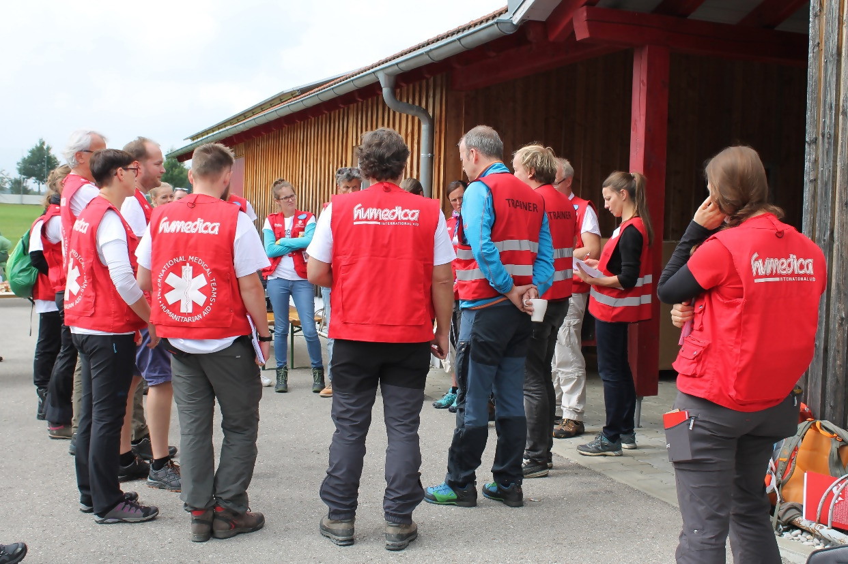
8. Operational “time-out” management

Slide 16
8.1. “Time-out” management during exercises
Time-outs are real-time breaks from the simulated exercise environment
Time-outs can be called either the participants or from the trainers/ExCon
PARTICIPANTS:
  in situations
    of medical urgencies
    that seem dangerous to them in order to alert the ExCon
  Participants should refrain from calling a time-out if only their tasks seem unclear to them or if they have situational questions they would like specified
TRAINERS:
  the exercise is going in a totally different direction than originally intended and the attainment of the exercise objective is threatened due to this deviation
  they are informed or become aware of a potentially dangerous situation

Slide 17
8.2. 10 for 10 Principle
The principle means that you invest 10 seconds to have 10 minutes of a better running exercise. (the time periods meant symbolically)
The time-out can be seen as successful if the performance of the team has improved and the exercise runs more coordinated than before.
Ask the team to stop their activities
All participants listen to the trainers
All information about the current exercise and situation is gathered
Advices and suggestions are put forward and concerns are communicated to all
Followed by a plan for the continuation of the exercise.
Then the exercise continues
It is important to keep the “time-out” as short as possible but as long as needed

Slide 18
9. Recognising and managing deviations and disruptions
There are two categories of deviations and disruptions which can occur during the TEAMS training implementation
In one category, it is the participant who caused a deviation or disruption of the exercises, in the second category the deviation is related to technical problems
Both categories require some flexibility and creativity by the trainers to keep the impact of the deviation or disruption as little as possible
Preparing for deviations and disruptions includes knowing your team well and familiarizing yourself with the training setting and venue
Having a motivated team, will help you to facilitate the training as planned in the foreseen timeframes without avoidable disruptions
You will not be able to prepare for each situation. Here, your flexibility, spontaneity and functioning as a trainer team comes into play

Slide 19
10. Tips for time management during the deployment
Take regular breaks.
Use ‘dead’ travel time to write emails, read and organize.
Write up tomorrow’s to-dos before the day ends.
Do urgent and important tasks first not the easy things.
Talk to
people.
Share tasks or problems with others.
Try to avoid switching between tasks.
Stop going to meetings that are not really important or where you don’t contribute to.
Remind yourself why you’re doing it.
Have lunch together with the whole team.
Set time limits for each task.
Keep a to-do list and update it daily.
Use a time log.

