Slide 1
Physical Context in Training and Facilitation

Slide 2
1
2
3
4
How to arrange a room to facilitate an interactive learning experience
Understand the principles of group dynamics and how to manage a
In this video your will learn about…
Principle of space and classroom management
Use proxemics to enhance the effectiveness of the activities

Slide 3

Topics
Here are the topics this video is focusing on in terms of physical context for training and facilitation:
Setting up the Learning Space
Classroom Management
Group Facilitation and Interaction Types
Experiential Learning and Debriefing
Group Dynamics

Slide 4
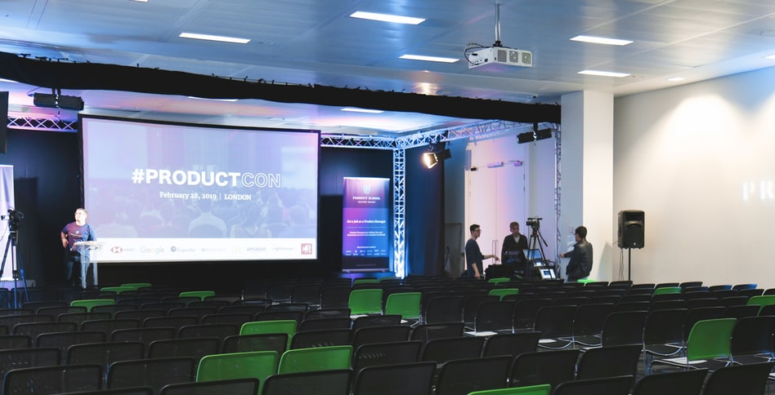
Learning Space Design
The way the room is set up will influence the interaction within the group and the participants’ learning process.
Here are some important suggestions that will help trainers setting up an ergonomic learning space:
VISUALS. For instance, flipcharts to remind participants of the essential theory of a session.
ROOM SETUP
is the seating arrangement of participants – the placement by which they receive content and interact with one another.
Notes:
Having the session’s flip charts on the walls around can help remind participants of the essential theory of a session. A set of flip charts full of post-it notes created by participants themselves during exercises can provide a sense of creativity and progress.
Table and chair arrangements likewise affect the learning process, as do the kinds of settings you use for group work and individual presentations. It is a critical aspect because the atmosphere the physical space creates will impact both the speaker’s effectiveness and the interaction of the audience members.

Slide 5
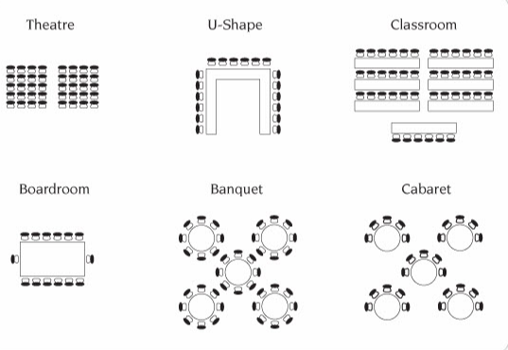
Learning Space Design- Room Set Up
Here are the more common types of room arrangements recapped
Theatre
U-Shape
Classroom
Boardroom
Banquet
Cabaret
Notes:
Theater Style
Theatre style room arrangement is a classic one: participants are seated in rows of chairs, much like in a theater or cinema, to watch and listen to a speaker or several speakers as well as visual and auditory aids. There’s generally a gap in the middle to allow easy access for central seats and a large stage to accommodate speakers, visuals and auditory aids. This style, thus, is typical for events with a large number of attendees where content is delivered as a lecture.
U-Shape
A U-shaped seating arrangement is just what the name describes – a letter U setup of tables and chairs arranged in an open-ended shape with the participants facing inwards. It is a classic boardroom setup that enables members to both face each other and the speaker.
Removing the tables and only having chairs in a U-shape allows for open interaction between the trainers and participants. This version is often used for soft skills development trainings and workshops.
Banquet Style
The banquet style room arrangement is a round table setup with participants facing each other like at a dinner table. This encourages full interaction between people sitting at one table. It is often used for interactive workshops with group discussions and exercises.
Boardroom or Conference Style
Conference or boardroom style has one large table that fits around 7 to 20 people with room for their various equipment such as laptops, mobile devices and video conferencing devices. All participants face the middle to enable discussion and interaction from all directions. The boardroom or conference style can also be adjusted to include many tables that form a hollow square/rectangle.
Classroom Setup
It is a classic classroom style where tables and chairs are arranged in parallel rows facing the front of the room. It is common for lectures and primarily supports interaction between the speaker and the audience and less between participants. Although, participants sharing a table can do small group exercises or sharing their work with one another.
Crescent (Rounds) or Cabaret Style
As the name suggests, members of the audience are seated in a round table but leaving empty space towards the stage or the location of the speaker. Tables are either scattered or strategically placed to maximize engagement as well as line of vision. The setup is conducive to small group exercises or discussions while keeping a focus on centrally displayed information or a speaker.

Slide 6
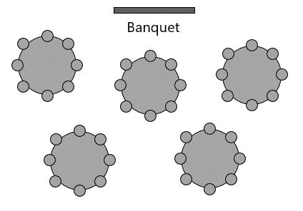
Considerations when choosing a supportive room design (part I)
2. Will participants need to use laptops, or have note taking/sketching space?
1. Will the seating arrangement need to be changed during the session?
4. Consider where snacks and meals will be served. A break room should be available
3. What type of visuals do you plan to use. Slides? Video conferencing?
Notes:
Here are few further considerations when choosing a supportive room design :
Will the seating arrangement need to be changed during the session? If yes, avoid using a place where tables are fixed to the ground.
Will participants need to use laptops, or have note taking/sketching space?
What type of visuals do you plan to use. Slides? Flipcharts? Video conferencing? Make sure all participants have an unobstructed view of the visuals so that they don’t need to twist and turn to see the visuals.
Usually, the number of chairs should match with the number of participants, allowing a few extra chairs in case you have extra participants.
Consider where snacks and meals will be served. You might want to dedicate some extra tables to coffee break supplies when a break room is unavailable.

Slide 7

Considerations when choosing a supportive room design (part II)
Lights
Heating and cooling
Consider how your own position can influence participation
Power and supply outlets
Additional Furniture
Notes:
Power supply and outlets: There should be enough to accommodate charging of laptops and other electronic devices needed for training and exercises, placed accessible but strategically so not to hinder the speakers, trainers and participants. You don’t want people tripping over power cords.
Internet access: Do you want/need your participants to have internet access? If yes, make sure that the WiFi code is easily visible to everyone upon arriving. And if you need to use internet during the session for any task, make sure that the bandwidth is enough to accommodate everyone.
Heating and cooling: The venue must be warm or cool enough. For larger groups, expect that the temperature will rise over time with more people in the room.
Additional furniture: Aside from tables and chairs, what other furnishing should be added or removed from the room to provide better comfort and utility to both facilitators and participants?
Lighting: The venue must have enough lighting for speakers and participants to be able to see clearly but without being too bright.
Consider how your own position can influence participation:
If you like to move around while you speak, do a check from different seats to see which spots in the room might be blind to some. Make sure everyone can see you at all times.

Slide 8
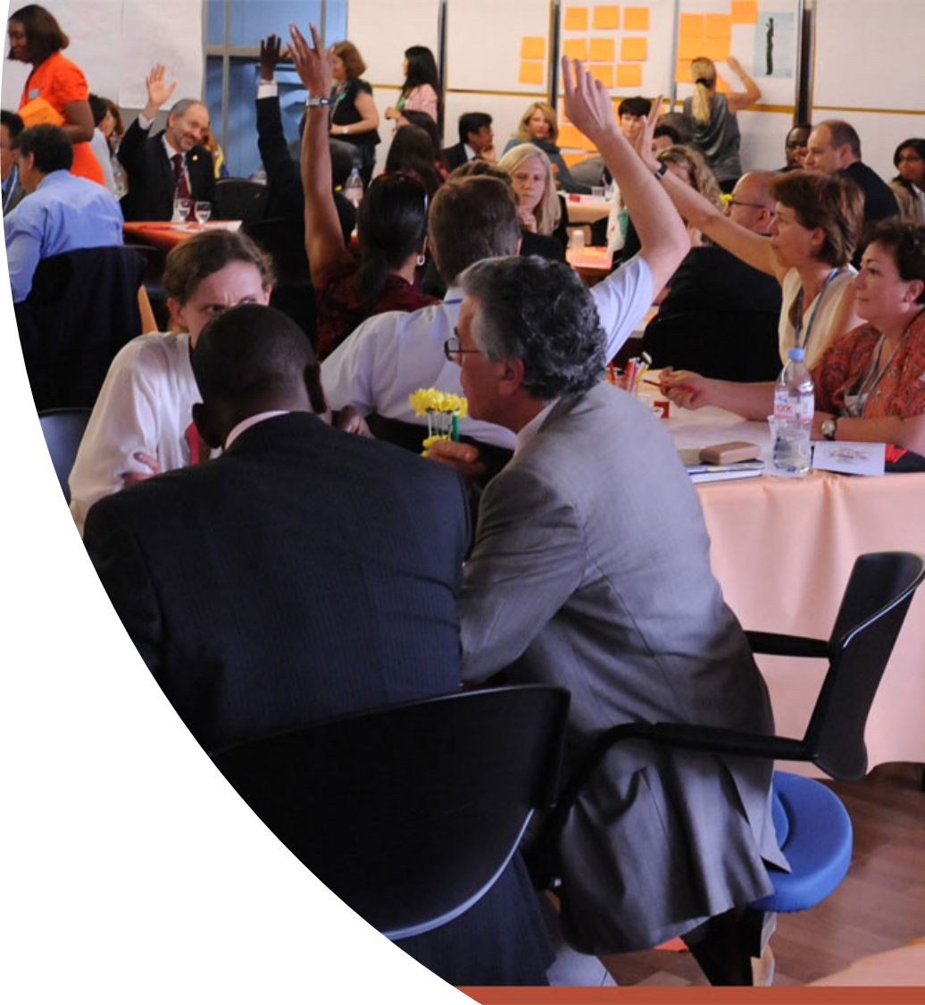

Classroom Management
When people from different backgrounds and life experiences meet to go through an intense learning event, there will inevitably be various reactions. Some might sit back, others will fully engage, and there will be some who will adopt blocking roles. This is a natural response to some sessions or specific tasks, so it is important that trainees be prepared to handle such situations.
Try to arrange a facilitated group discussion or a Word Café style conversation to discuss different topics in smaller groups. This tip will:
Keep up the attention level (using different interaction techniques)
Help to handle difficult participants
If you look for a specific exercise to address challenging behaviors during a training session, then you might find useful the group exercise “Participants from Hell”. It gives a handy framework for letting participants brainstorm rules or guidelines for handling different kinds of disruptive behaviours.
Notes:
We’ve established that managing the attention and energy of people in the room is an essential responsibility of trainers. Beyond generic tips on how to keep up engagement and monitor the energy/attention level in the room, this session also covers how to deal with difficult participants and handle conflicts in the classroom.
When people from different backgrounds and life experiences meet to go through an intense learning event, there will inevitably be various reactions. Some might sit back, others will fully engage, and there will be some who will adopt blocking roles. This is a natural response to some sessions or specific tasks, so it is important that trainees be prepared to handle such situations.
These are situations with which most everyone has some previous personal experience, so a structured sharing session can be the right approach to leverage trainees’ existing knowledge.
As part of this block, arrange a facilitated group discussion or a rotating café style conversation to discuss different topics in smaller groups:
Keeping up the attention level (using different interaction techniques)
Handling difficult participants
Handling conflict situations.
If you look for a specific exercise to address challenging behaviours during a training session, then you might find useful the group exercise “Participants from Hell”. It gives a handy framework for letting participants brainstorm rules or guidelines for handling different kinds of disruptive behaviours.
This is a structured sharing activity that enables us to explore techniques for handling participants who disrupt interactive training sessions.
Different teams receive envelopes labeled with different types of disruptive participants. Participants brainstorm guidelines for handling disruptive behaviours, record the guidelines on a card, and place the card inside the envelope.
Teams rotate the envelopes and generate guideline cards for handling other types of disruptive participants. During the evaluation round, team members review the guideline cards generated by other teams and identify the top five suggestions.

Slide 9

Methods to facilitate interaction within a group
If your participants sit in a theater-style arrangement during a whole session, sooner or later you will hear snoring sounds.
Likewise, if you only switch between plenary discussion and individual work, your participants might get bored of the monotony.
Trainers should be aware of the most frequently-used methods to facilitate interaction within a group:
One-way presenting
Individual reflection
Working in groups
In pairs, triads and bigger groups
Plenary discussion (with the whole group)

Slide 10
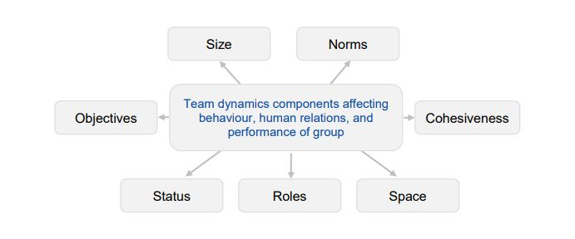
Components of group dynamics
As a trainer, it is highly useful to be conscious of the dynamics taking place in the group and to be aware of the best ways to deal with a group depending on its dynamics.
Notes:
Group dynamics play an important role not just in the training room but in our everyday lives, too. As a trainer, it is highly useful to be conscious of the dynamics taking place in the group and to be aware of the best ways to deal with a group depending on its dynamics. In this session, therefore, we introduce the topic of group dynamics and its influence on the training process. There are 7 parts of group dynamics that can determine patterns of interactions between the members of the group:
- Size (number of participants)
- Norms (or rules – from work or established by the facilitator)
- Cohesiveness (e.g. if they worked together before)
- Roles (roles from work environment are brought into the training room
- Status (is it a formal or informal group?)
- Objectives (are all members aware of the objectives of the training and striving for them?)
- Space (is physical space adequate to the training and exercises are customized according to the space available?)

Slide 11

Space in tabletop exercises
Tabletop exercises have different traits compared to other types of activities.
- Participants are usually sitting around a table or in a defined space and all materials about the case study are provided in advance.
- The workspace should be properly equipped with flipcharts, pens and chairs. If possible visuals should be hang on walls to facilitate visualization.
- Interactions among participants are as important as the exercise itself, sometimes more important than the final outcome. Set up a space that facilitates dialogues.
Notes:
Tabletop exercises have different traits compared to other types of activities.
- Participants are usually sitting around a table or in a defined space and all materials about the case study are provided in advance.
- The workspace should be properly equipped with flipcharts, pens and chairs. If possible, posters, infographics, pictures related to the topic discussed should be hang on walls to facilitate visualization.
- Interactions among participants are as important as the exercise itself, sometimes more important than the final outcome. Set up a space that facilitates dialogues.

Slide 12
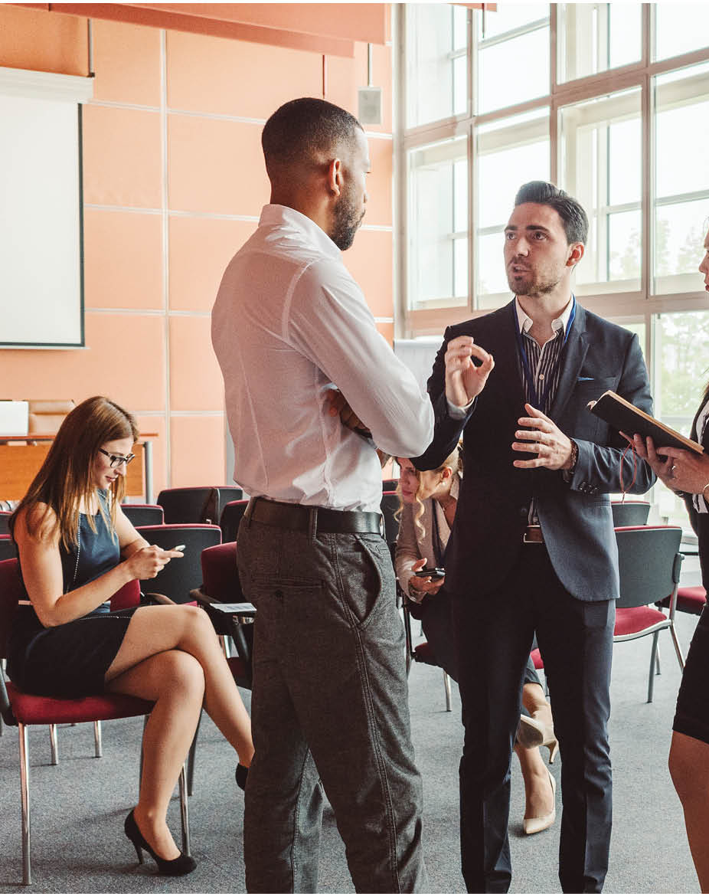

Conclusions
There are a lot of small details to pay attention to when running a session, ranging from logistics issues (making sure that all materials needed are taken care of, the room is set up etc) to body language.
Managing the attention and energy of participants in the room is an essential responsibility of trainers.
A thoughtful design of the training room is an important aspect of facilitating learning.

