Slide 1
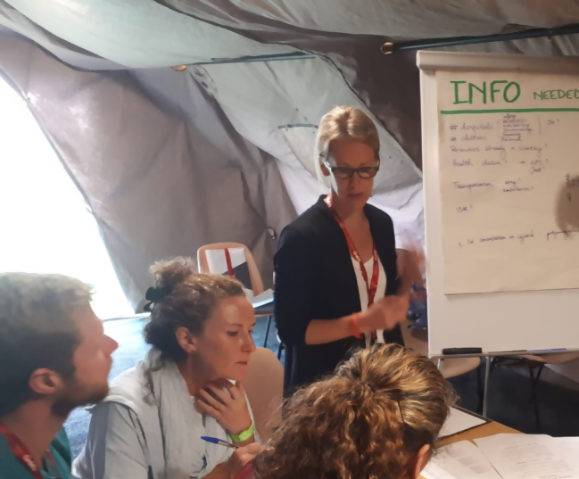
FACILITATION

Slide 2
In this video your will learn about…
Concept of facilitation
How to plan and prepare for effective facilitation
How to manage possible challenges while facilitating exercises
Principles of adult learning
Characteristics and skills of a good facilitator
Facilitation strategies throughout exercises
Notes:
In this video your will learn about
Some basic principles of adult learning, and how to integrate them into facilitation
The main characteristics and skills of a good facilitator
How to prepare for effective facilitation
Some practical facilitation strategies to implement throughout exercises
And how to manage possible challenges while facilitating exercises

Slide 3
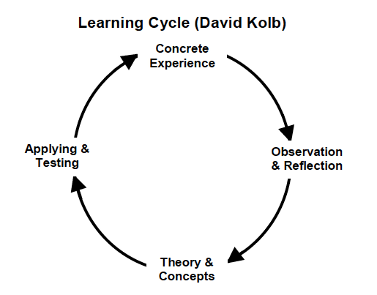
Principles of adult learning
Learning Cycle (David Kolb)
LEARNING is a change in behavior that occurs as a result of practice, experience and reflection.
Notes:
Learning is a change in behavior that occurs as a result of practice, experience and reflection. As we can see in the learning cycle, as described by David Kolb, experience leads to reflection and this reflections to new theory and concepts that can again be applied and tested through practice, to be improved or generate new theories and concepts.

Slide 4
Principles of adult learning
Through TEAMS training exercises – Practice and experience
Debriefing - Reflection
At the start - Participants’ knowledge and skills
Notes:
We can now see how the TEAMS training fits into this cycle:
At the beginning of the training, participants bring their own knowledge and skills. Those are put in practice throughout the different exercises, and will lead to concrete experiences that participants will reflect upon. These group reflections will allow them to acquire and generate new knowledge that they can use in their future practice.
So, what is the role of facilitators within this learning cycle?

Slide 5
What is facilitation?
Facilitation is the act of helping training participants learning through self-discovery, by exposing them to experiences and guiding them from practice to reflection
Encourage
critical thinking and analysis
Build
trust and respect between group members
Keep
the group within the scope of the training
Notes:
Facilitation is the act of helping training participants learning through self-discovery, by exposing them to experiences and guiding them from practice to reflection.
The role of facilitators involves:
Encouraging groups to critically think and analyze situations that will lead them to reaching meaningful conclusions.
Building trust and respect between the members of the group and encouraging dialogue and learning.
Keeping group members within the scope of the training so they can achieve pre-defined learning objectives by themselves

Slide 6



Consider…
Facilitation and teaching
are different!
Notes:
Consider that Facilitation and teaching are different!
While facilitation is built on participants’ knowledge and experience, teaching starts from the teacher’s own knowledge and the information flows in only one direction (from teacher to student).
Remember that facilitators should let the training participants be in charge of their learning process, and just concentrate on promoting positive and effective group dynamics and maintaining the group within the scope and objectives of the training

Slide 7
Characteristics and skills of a good facilitator
Personal characteristics
Non verbal skills
Verbal skills
Warm
Inclusive
Sensitive to others’ needs
Willing to learn from mistakes
Dynamic, motivating, enthusiastic
Good listener
Look around the whole group
Stand up when speaking
Look relaxed but confident
Move around without distracting the group
Use gestures and actions to keep attention
Speak slowly and clearly, use concrete examples
Adapt the language to the level of the group
Let and help participants do most of the talking
Rephrase participants thoughts and feelings and summarize ideas
Notes:
Here are some characteristics and skills recognized in a good facilitator:
list

Slide 8
Planning to facilitate an exercise
Know the training package
Choose right learning environment
Prepare the materials needed
EXERCISE PLANNING
Know yourself
Know the training participants
Health and safety
Set a schedule
Notes:
There are a series of important steps that facilitators need to take to ensure that the training event is well planned and facilitated, and therefore translates into a successful learning experience achieving the expected objectives. These steps include:
Know yourself: what are your strengths and weaknesses, and how to improve your facilitation skills
Know the training package, by reading and analizing all the training carefully, and adapting it if needed
Know the training participants: who they are, what are their background, experience and training needs
Choose and set up the right learning environment, which should encourage participation and enable all planned activities
Set a schedule, by previously assessing what will be the right timing for each training activity
Prepare all materials needed well in advance
Ensure health and safety aspects are covered, identifying all possible hazards that may affect the training and providing everyone involved with appropriate information and equipment to handle potentially dangerous tasks or equipment

Slide 9


Facilitation strategies
Build a relationship of trust between training faculty and participants
At the beginning of the exercise…
Agree the ground rules
Promote positive interactions among participants
Start building up participants’ motivation
Notes:
We will now present some strategies that will help facilitating learning through the different phases of a training event.
At the beginning of an exercise it is important to:
Start building a relationship of trust and equity between the training faculty and the participants
Promote positive interactions between participants
Agree the ground rules. Set out and agree with participants the way facilitators and learners will relate to each other, and what are their rights and responsibilities during the event

Slide 10
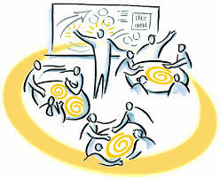
Facilitation strategies
Follow the progression of the exercise according to plan
While performing exercises…
Check participants involvement and motivation
Check if the task is clear and well focused towards achieving the learning objectives
Minimize interactions with participants as much as possible
Notes:
While participants are fully immersed in the simulation and actively involved in achieving the expected learning objectives, the facilitator should focus on aspects like:
Follow the progression of the exercise according to plan. Change timing if needed, shortening or prolonging certain stages of the exercise
Check if the tasks are clear and well focused towards achieving the learning objectives. Otherwise, consider a technical stop to refocus or explain again the tasks
Check participants involvement and motivation.
Remember to minimize the interactions with participants as much as possible so they can focus and work independently. Take notes about their performance and bring them up in the debriefing session once the exercise is finished.

Slide 11


Facilitation strategies
Summarize and consolidate what has been learnt
At the end of the training…
Emphasize the achievement of the learning objectives
Gather feedback about the training event
Notes:
At the end of the training event, facilitators should
- Consolidate what has been learnt. Encourage participants to summarize the main lessons learnt during the training (for example, revealed individual and group strengths and weaknesses, new knowledge and skills acquired, etc.).
Emphasize the achievement of the learning objectives. Make sure you congratulate participants for their efforts and achievements.
Invite all participants to provide feedback about their impressions on the training (content, methods, organization, faculty) and suggestions for improvement.

Slide 12

Managing possible challenges
Dominant participants
Difficult questions
Diversionary participants
Conflicts
Shy participants
Lack of involvement
SUCCESSFUL TRAINING
Notes:
Multiple challenges can arise while facilitating exercises. The response to those will depend on each specific situation, but some general recommendations can help facilitators managing different scenarios that may appear and compromise the success of the training.
- As a facilitator you may be confronted by difficult questions, but do not panic! You don’t have to know all the answers. Tell participants you will get back to them later on that point, or throw the question back to the group, in case someone has an answer.
Conflicts between participants may arise. As a general rule, leave participants to solve conflicts by themselves. When you are moderator within the group, listen to everyone and refocus the discussion around the expected achievement of the tasks and learning objectives. Suggest participants to limit the conversation to key questions, and do not continue elaborating on the conflicting ideas.
You may observe low motivation or involvement of some participants. In that case, consider changing the group dynamic by splitting in smaller groups or changing their composition. You could also consider adding extra tasks or injects to increase action and dynamism. Help the group with hints or extra information if they seem to loose motivation cause they find the task too difficult.
If you identify shy participants, motivate their participation by giving them a specific role, and providing them with positive feedback after their contributions.
There may be dominant participants who tend to dominate discussions and frequently take decisions for the group. Place those people in leadership positions, to give them responsibilities, but ensure they allow the rest of the team members to participate and contribute. You may occasionally take out the more dominant participants to see how the rest of the groups reacts, cope and change their work dynamic.
There can also be participants who speak a lot but always bring up diversionary ideas that lead the group out of focus if not controlled. In that case, listen to their ideas, but re-focus the conversation when going out of scope. Ask the group to limit their discussions to the scope of the training or specific subject.

