Slide 1
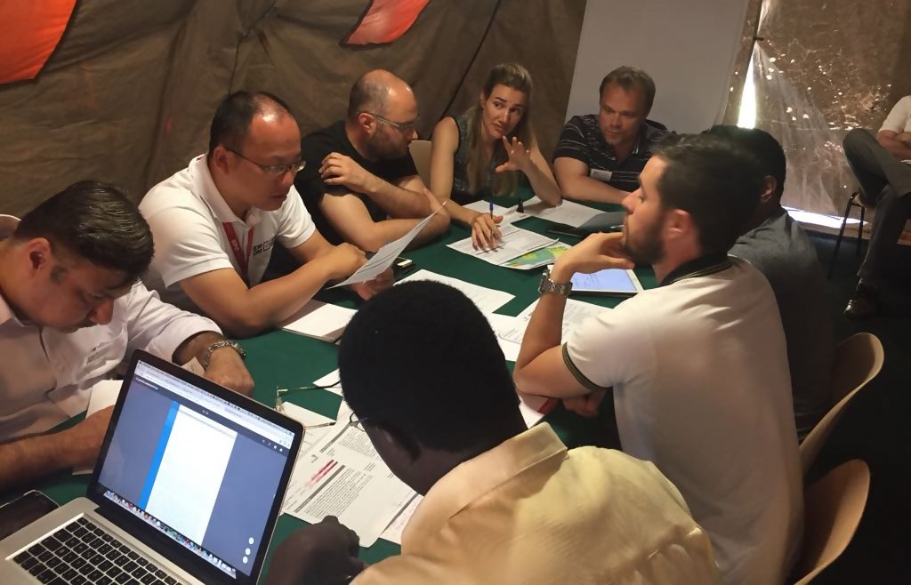
TEAM FORMATION

Slide 2

Team Composition
A well-composed team has members
who have the required complement of knowledge and skills, and can effectively integrate their efforts to achieve the team’s purpose

Slide 3
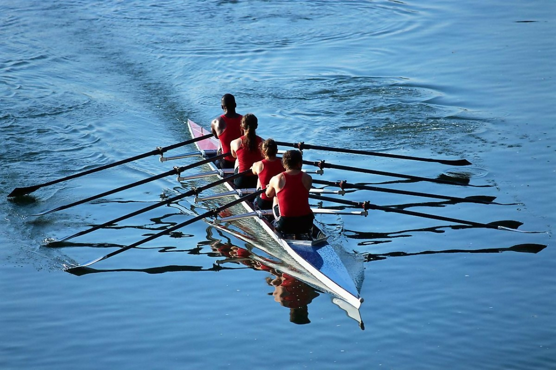
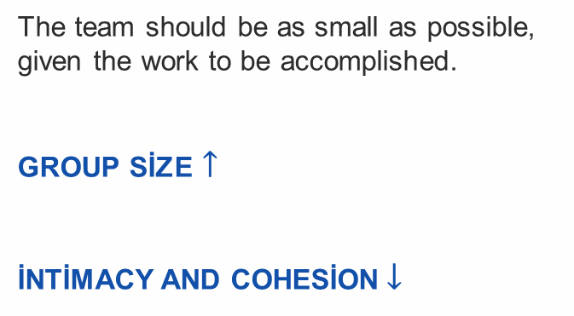
Team Composition
The team should be as small as possible, given the work to be accomplished.
GROUP SİZE $↑$
İNTİMACY AND COHESİON$↓$

Slide 4
Team Composition
When picking people for a team, a manager or supervisor must take into account each individual’s personality, social style, skills, and thought process.

Slide 5
Team Composition
Resource investigator
Monitor evaluator
PEOPLE
THINKING
ACTION
Teamworker
Specialist
Belbin’s roles:
Completer-finisher
Coordinator
Implementer
Monitor-evaluator
Belbin team roles
Coordinator
Plant
Shaper
Implementer
Completer finisher

Slide 6
Team Composition
Resource investigator
Monitor evaluator
PEOPLE
THINKING
ACTION
Teamworker
Specialist
Belbin’s roles:
Plant
Resource investigator
Shaper
Specialist
Team worker
Belbin team roles
Coordinator
Plant
Shaper
Implementer
Completer finisher

Slide 7

Team Composition
Belbin’s theory focused on naturally emerging personalities, but team composition research usually focuses on the attributes of team members that affect the ABCs of teamwork and performance

Slide 8

Team Composition
Surface-level attributes: readily detectable categories (e.g., age, sex, race) and easily accessible information (e.g., reputation, role)
Deep-level attributes: underlying psychological characteristics (e.g., personality traits, abilities, values, attitudes)

Slide 9



Team Composition
Birds of a feather may flock together, but that does not necessarily translate to confidence in the team.
The influence of surface-level composition on the ABCs of teamwork is highly dependent on the situation.

Slide 10

Team Composition
Team composition facilitates the emergence of team moods.
Teams with members who value teamwork are more confident and cooperative.
Teams with conscientious members self-regulate teamwork.

Slide 11

Team Composition
Teams with sociable members develop better teamwork, and their members care about reciprocation.
Teams with high ability members are more likely to work well together.

Slide 12
Team Development Stages
TUCKMAN'S STAGES of Group Development:
Little agreement
Unclear purpose
Guidance and Direction
Conflict
Increased clarity of purpose
Power Struggles
Coaching
Agreement and Consensus
Clear Roles and Responsibility
Facilitation
Clear Vision and purpose
Focus on goal achievement
Delegation
Task completion
Good feeling about achievements
Recognition
FORMING
STORMING
NORMING
PERFORMING
ADJOURNING

Slide 13
Team Development Stages
Wheelan’s integrated model of group development:
Dependancy and inclusion
Counterdependancy and fight
Trust and structure
Work
1
2
2
3
3
4
1
4

Slide 14
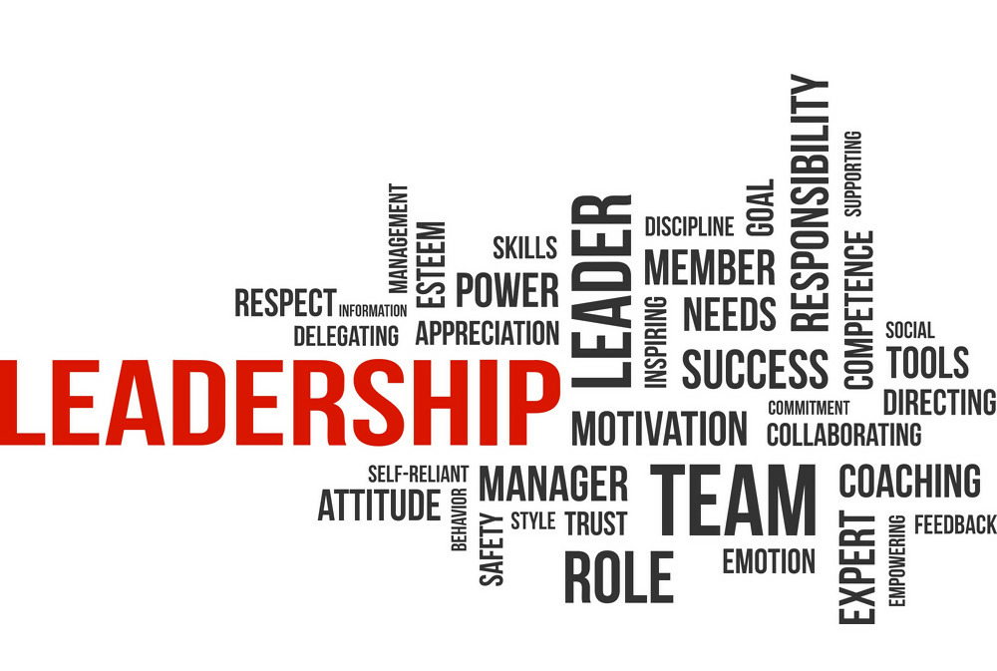
Team Leadership
Team leaders play a pivotal role in shaping collective norms, helping teams cope with their environments, and coordinating collective action.
LEADER
LEADERSHIP

Slide 15
Team Leadership
1
Organizational teams, like human groups more generally, seldom have just ONE LEADER.
Even when there is a formally assigned team leader, other, informal, leaders can emerge

Slide 16
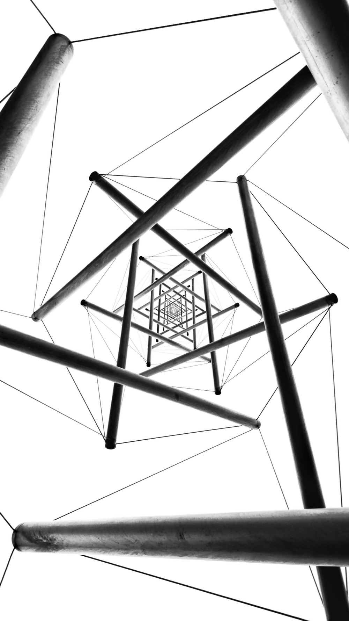
Team Leadership
LEADERSHİP is not just a top-down process between the formal leader and team members; and there can be multiple leaders within a group

Slide 17
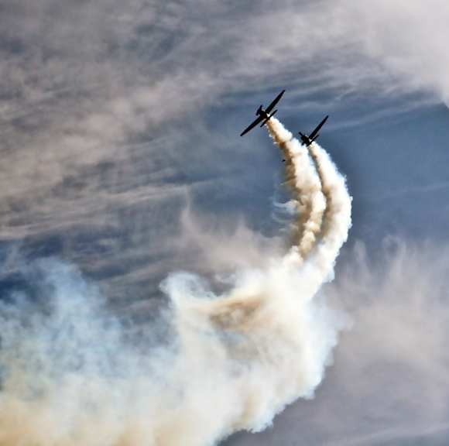
Team Leadership
What may be most important from the perspective of group performance is whether the FORMAL AND EMERGENT LEADERS are able to COORDİNATE effectively.
COORDINATE

Slide 18

Team Leadership
When FORMAL AND EMERGENT LEADERS recognize one another as leaders, they should be better able to SYNCHRONİZE their leadership efforts so that decision making and action are more effectively channeled within the group.
SYNCHRONİZE

